Slide 1
Why we need to learn Programming language?
Premanand S

Slide 2
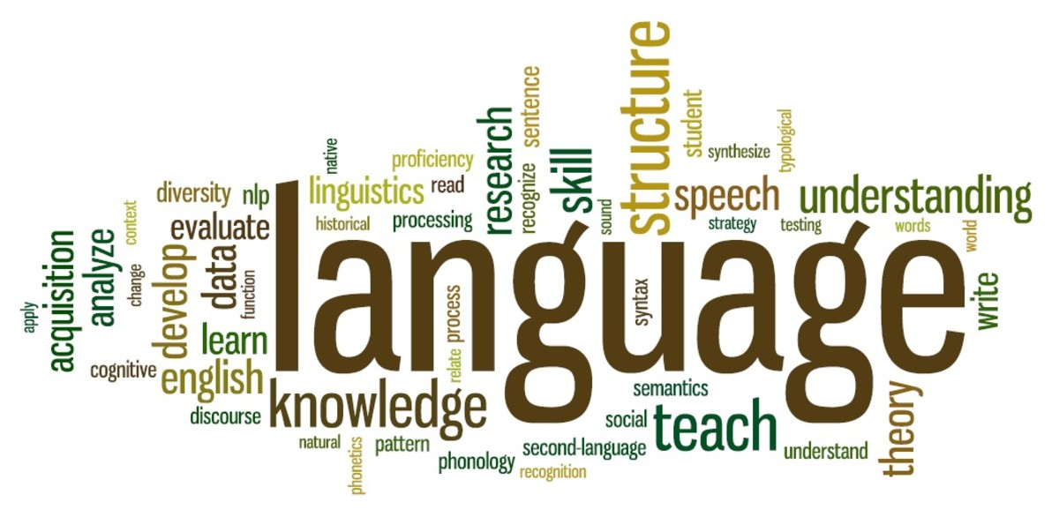
Language

Slide 3
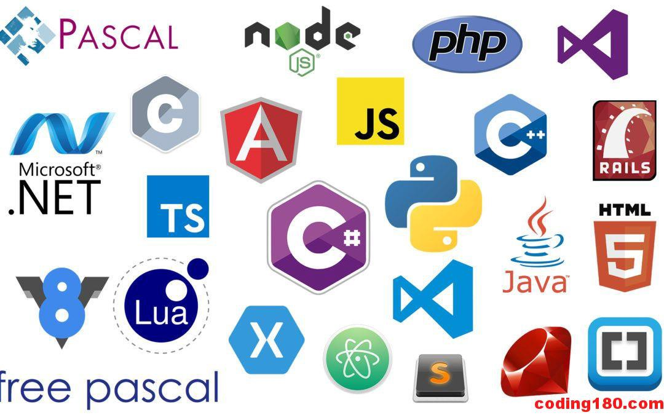
Programming Language

Slide 4
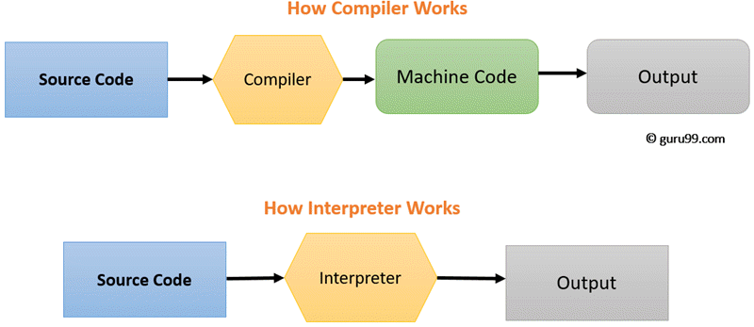
Complier Vs Interpreter

Slide 5
Compiler Vs Interpreter
 | Compiler | Interpreter
Analysis | Entire program | Line by line program
Machine Code | Stores MC in disk storage | Not stored
Execution | Execution happened after entire program compiled | Line by line executed
Run time | faster | Slower
Input | It takes entire program for compiling | Line by line
Output | Gives intermediate code forms | not
Error & it’s execution | All errors at the end, it wont run until solved | Displays line to line, program runs till the error is found
Programming languages | C, C++, Java | PERL, Ruby

Slide 6
Types of Programming language
Low level Programming language
High level Programming language
Middle level programming language

Slide 7
Low level Programming language
Machine dependent (0s and 1s)
No need of compiler and interpreter
Runs very fast
Types:
1. Machine language
2. Assembly language

Slide 8
High level Programming language
Developing user-friendly software programs and websites.
Need compiler or interpreter
Easy to read and write
Python, Java, JavaScript, PHP, C#, C++, Objective C, Cobol, Perl, Pascal, LISP, FORTRAN, and Swift programming language.
Types:
1. Procedural Oriented programming language
2. Object-Oriented Programming language

Slide 9

POP Vs OOPs
S.No | POP | OOP
1 | Deals with algorithm | Deals with data
2 | Programs are divided into function | Divided into objects
3 | Less memory | More memory
4 | Do not support for new data types | supports
5 | Data security is poor | good
6 | Not supported for real time | supports
7 | Ex: C, Fortran | Ex: Python, C++

Slide 10
Middle level Programming Language
Lies between the low-level programming language and high-level programming language
Supports the features of high-level programming
C, C++

Slide 11
Understanding about Programming Language
Programming is the process of creating a set of instructions that tell a computer how to perform a task.
Communication tool
Analogy – Construction
It’s the ability to take an idea, break it apart to individual pieces and write the statements in proper order, using proper syntax, so that it can be fed to a machine to get the desired results.

Slide 12
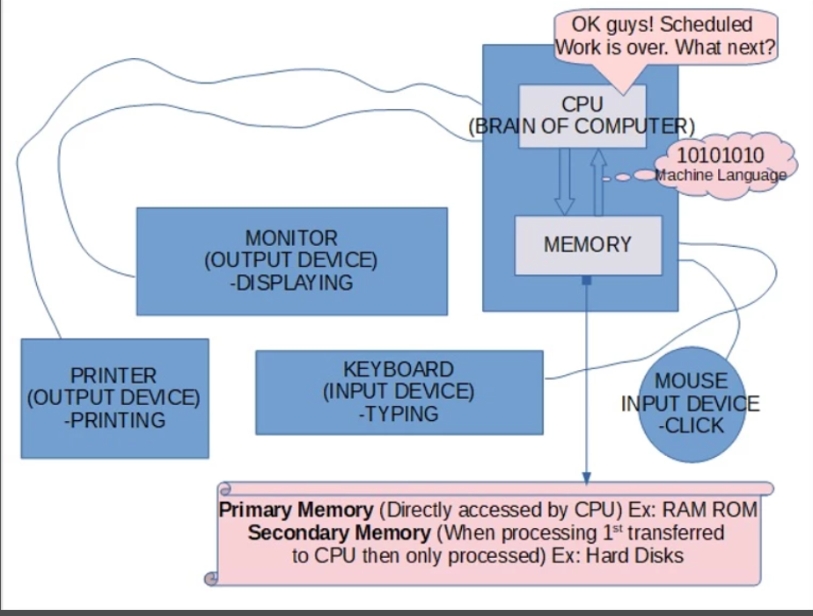
Importance of Programming Language

Slide 13

Programming - Explanation

Slide 14
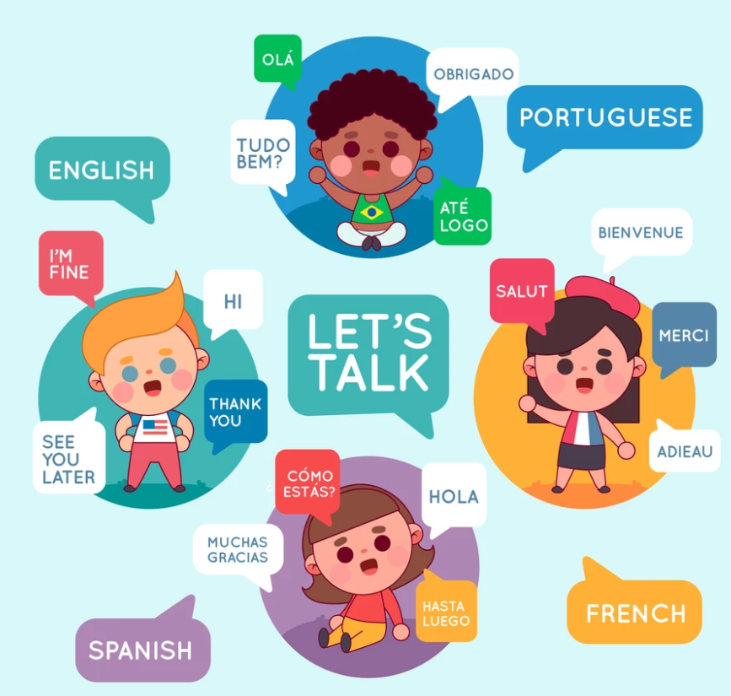
Programming Language - Usage

Slide 15
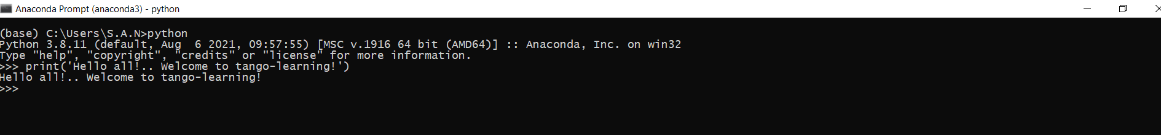
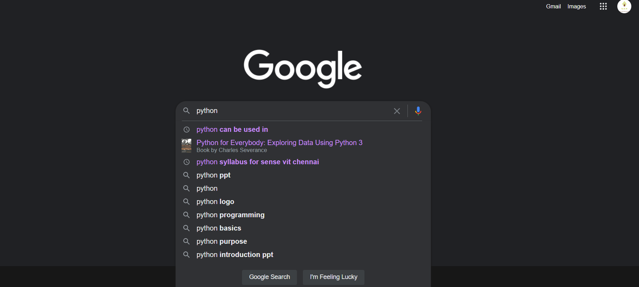
Do machines speak?

Slide 16
Verdict – Language (Programming)
I think for any relationship to be successful, there needs to be loving communication, appreciation, and understanding.

Slide 17
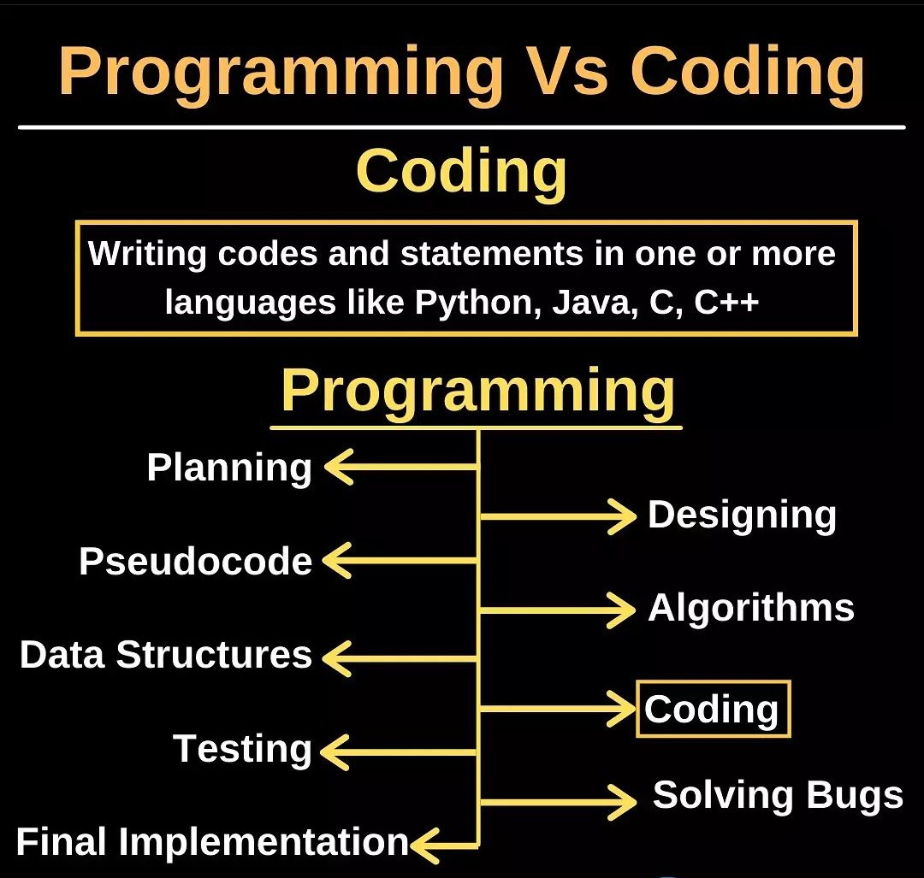
Programming Vs Coding

Slide 18
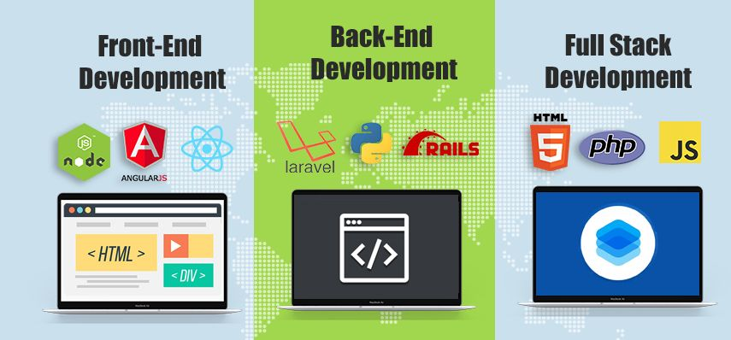
Front End Vs Back End Vs Full Stack development

Slide 19
Back End | Front End | Full Stack
Server side | Client side | Can built either side of a website
Manges database | Enhance program functionality and Visualization style | Entire web project
Ex: Ruby, Python | Ex: HTML, Angular Proficiency | Ex: All programming language

Slide 20
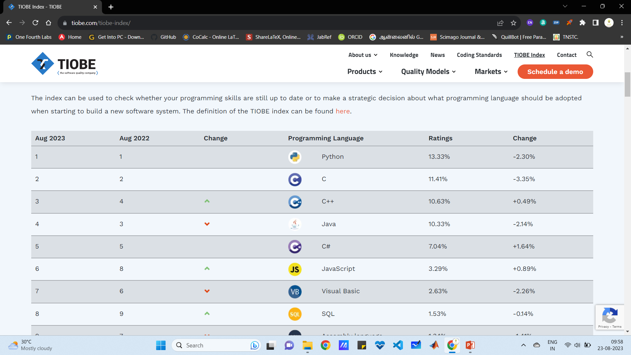
Python – best Programming Language
https://www.tiobe.com/tiobe-index/

